Slide 1
2.1 Introduction
A word is a contiguous group of bytes.
  Words can be any number of bits or bytes.
  Word sizes of 16, 32, or 64 bits are most common.
  In a word-addressable system, a word is the smallest addressable unit of storage.
A group of four bits is called a nibble.
  Bytes, therefore, consist of two nibbles: a “high-order nibble,” and a “low-order” nibble.

Slide 2
2.2 Positional Numbering Systems
Bytes store numbers using the position of each bit to represent a power of 2.
  The binary system is also called the base-2 system.
  Our decimal system is the base-10 system. It uses powers of 10 for each position in a number.
  Any integer quantity can be represented exactly using any base (or radix).

Slide 3
2.2 Positional Numbering Systems
The decimal number 947 in powers of 10 is:
The decimal number 5836.47 in powers of 10 is:
  9 × 10 ² + 4 × 10 ¹ + 7 × 10 ⁰
  5 × 10 ³ + 8 × 10 ² + 3 × 10 ¹ + 6 × 10 ⁰
  + 4 × 10 ⁻¹ + 7 × 10 ⁻²

Slide 4
2.2 Positional Numbering Systems
The binary number 11001 in powers of 2 is:
When the radix of a number is something other than 10, the base is denoted by a subscript.
  Sometimes, the subscript 10 is added for emphasis:
  11001₂ = 25₁₀
  1 × 2 ⁴ + 1 × 2 ³ + 0 × 2 ² + 0 × 2 ¹ + 1 × 2 ⁰
  = 16 + 8 + 0 + 0 + 1 = 25

Slide 5
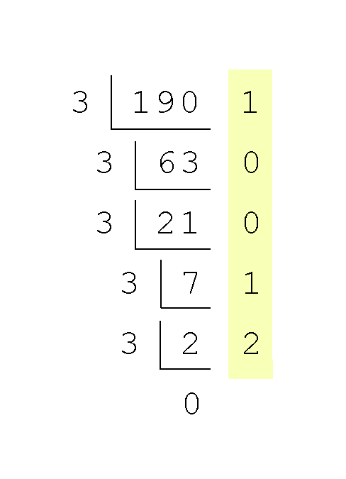
2.3 Converting Between Bases
Converting 190 to base 3...
  Continue in this way until the quotient is zero.
  In the final calculation, we note that 3 divides 2 zero times with a remainder of 2.
  Our result, reading from bottom to top is:
  190₁₀ = 21001₃

Slide 6
2.3 Converting Between Bases
Converting 190 to base 2
  190₁₀ = 10111110₂
2 | 190
2 | 95 | 0
2 | 47 | 1
2 | 23 | 1
2 | 11 | 1
2 | 5 | 1
2 | 2 | 1
2 | 1 | 0
 | 0 | 1

Slide 7
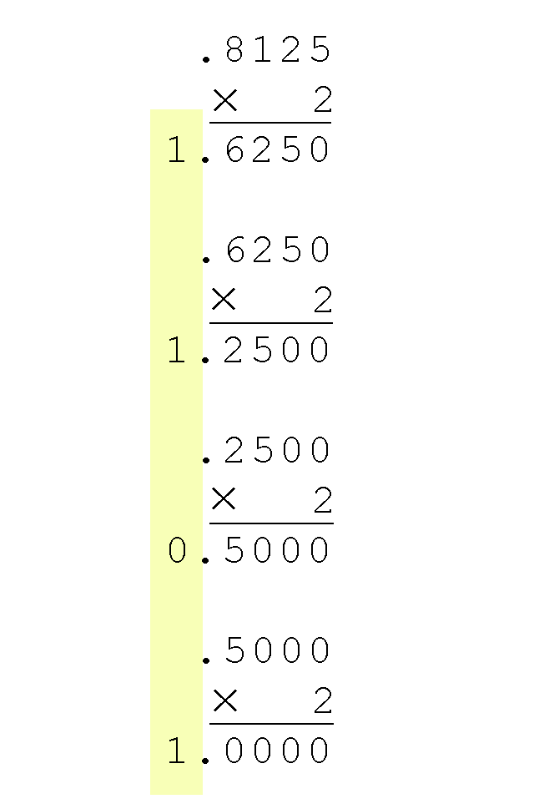
2.3 Converting Between Bases
Converting 0.8125 to binary . . .
  You are finished when the product is zero, or until you have reached the desired number of binary places.
  Our result, reading from top to bottom is:
  0.8125₁₀ = 0.1101₂
  This method also works with any base. Just use the target radix as the multiplier.

Slide 8
2.3 Converting Between Bases
The binary numbering system is the most important radix system for digital computers.
However, it is difficult to read long strings of binary numbers -- and even a modestly-sized decimal number becomes a very long binary number.
  For example: 11010100011011₂ = 13595₁₀
For compactness and ease of reading, binary values are usually expressed using the hexadecimal, or base-16, numbering system.

Slide 9
Decimal,
Binary,
Hexadecimal,
Octal
Decimal | Binary | Hexadecimal | Octal
0 | 00000 | 0 | 0
1 | 0001 | 1 | 1
2 | 0010 | 2 | 2
3 | 0011 | 3 | 3
4 | 0100 | 4 | 4
5 | 0101 | 5 | 5
6 | 0110 | 6 | 6
7 | 0111 | 7 | 7
8 | 1000 | 8 | 10
9 | 1001 | 9 | 11
10 | 1010 | A | 12
11 | 1011 | B | 13
12 | 1100 | C | 14
13 | 1101 | D | 15
14 | 1110 | E | 16
15 | 1111 | F | 17

Slide 10
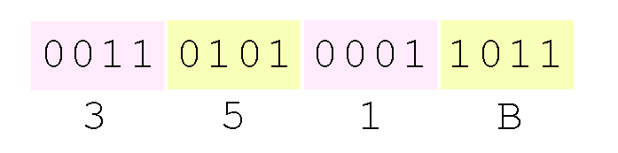
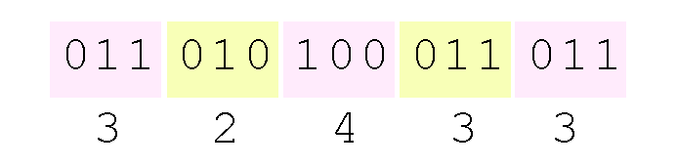
2.3 Converting Between Bases
Using groups of hextets, the binary number 11010100011011₂ (= 13595₁₀) in hexadecimal is:
Octal (base 8) values are derived from binary by using groups of three bits (8 = 2³):
If the number of bits is not a multiple of 4, pad on the left with zeros.
Octal was very useful when computers used six-bit words.

Slide 11
2.4 Signed Integer Representation
The conversions we have so far presented have involved only unsigned numbers.
To represent signed integers, computer systems allocate the high-order bit to indicate the sign of a number.
  The high-order bit is the leftmost bit. It is also called the most significant bit.
  0 is used to indicate a positive number; 1 indicates a negative number.
The remaining bits contain the value of the number (but this can be interpreted different ways)

Slide 12
2.4 Signed Integer Representation
There are three ways in which signed binary integers may be expressed:
  Signed magnitude
  One’s complement
  Two’s complement
In an 8-bit word, signed magnitude representation places the absolute value of the number in the 7 bits to the right of the sign bit.

Slide 13
2.4 Signed Integer Representation
For example, in 8-bit signed magnitude representation:
  +3 is: 00000011
  - 3 is: 10000011
Computers perform arithmetic operations on signed magnitude numbers in much the same way as humans carry out pencil and paper arithmetic.
  Humans often ignore the signs of the operands while performing a calculation, applying the appropriate sign after the calculation is complete.

Slide 14
2.4 Signed Integer Representation
Binary addition is as easy as it gets. You need to know only four rules:
  0 + 0 = 0 0 + 1 = 1
  1 + 0 = 1 1 + 1 = 10
The simplicity of this system makes it possible for digital circuits to carry out arithmetic operations.
Let’s see how the addition rules work with signed magnitude numbers . . .

Slide 15
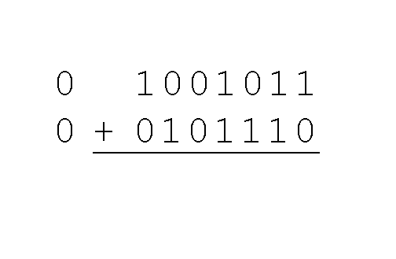
2.4 Signed Integer Representation
Example:
  Using signed magnitude binary arithmetic, find the sum of 75 and 46.
First, convert 75 and 46 to binary, and arrange as a sum, but separate the (positive) sign bits from the magnitude bits.

Slide 16
2.4 Signed Integer Representation
Signed magnitude representation is easy for people to understand, but it requires complicated computer hardware.
Another disadvantage of signed magnitude is that it allows two different representations for zero: positive zero and negative zero.
For these reasons (among others) computers systems employ complement systems for numeric value representation.

Slide 17
2.4 Signed Integer Representation
In complement systems, negative values are represented by some difference between a number and its base.
The diminished radix complement of a non-zero number N in base r with d digits is (r^{d} – 1) – N
In the binary system, this gives us one’s complement. It amounts to little more than flipping the bits of a binary number.

Slide 18
2.4 Signed Integer Representation
For example, using 8-bit one’s complement representation:
  + 3 is: 00000011
  - 3 is: 11111100
In one’s complement representation, as with signed magnitude, negative values are indicated by a 1 in the high order bit.
Complement systems are useful because they eliminate the need for subtraction. The difference of two values is found by adding the minuend to the complement of the subtrahend.

Slide 19
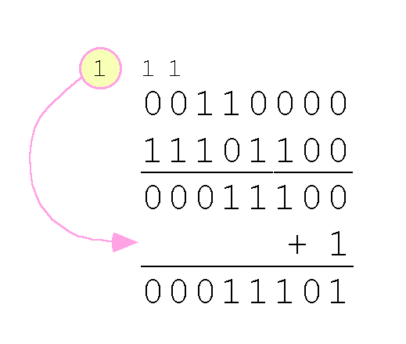
2.4 Signed Integer Representation
With one’s complement addition, the carry bit is “carried around” and added to the sum.
  Example: Using one’s complement binary arithmetic, find the sum of 48 and - 19
  We note that 19 in binary is 00010011,
  so -19 in one’s complement is: 11101100.

Slide 20
2.4 Signed Integer Representation
Although the “end carry around” adds some complexity, one’s complement is simpler to implement than signed magnitude.
But it still has the disadvantage of having two different representations for zero: positive zero and negative zero.
Two’s complement solves this problem.
Two’s complement is the radix complement of the binary numbering system; the radix complement of a non-zero number N in base r with d digits is r^{d} – N.

Slide 21
2.4 Signed Integer Representation
To express a value in two’s complement representation:
  If the number is positive, just convert it to binary and you’re done.
  If the number is negative, find the one’s complement of the number and then add 1.
Example:
  In 8-bit binary, 3 is: 00000011
  -3 using one’s complement representation is: 11111100
  Adding 1 gives us -3 in two’s complement form: 11111101.

Slide 22
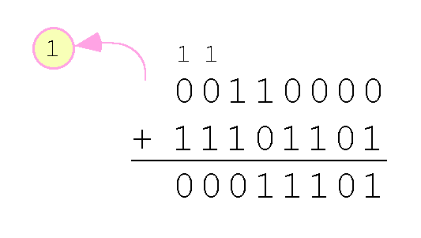
2.4 Signed Integer Representation
With two’s complement arithmetic, all we do is add our two binary numbers. Just discard any carries emitting from the high order bit.
Example: Using one’s complement binary arithmetic, find the sum of 48 and - 19.
  We note that 19 in binary is: 00010011,
  so -19 using one’s complement is: 11101100,
  and -19 using two’s complement is: 11101101.

Slide 23
2.4 Signed Integer Representation
When we use any finite number of bits to represent a number, we always run the risk of the result of our calculations becoming too large or too small to be stored in the computer.
While we can’t always prevent overflow, we can always detect overflow.
In complement arithmetic, an overflow condition is easy to detect.

Slide 24
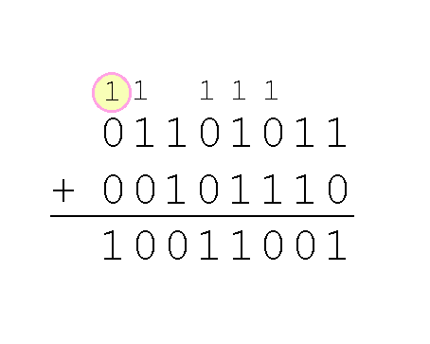
2.4 Signed Integer Representation
Example:
  Using two’s complement binary arithmetic, find the sum of 107 and 46.
We see that the nonzero carry from the seventh bit overflows into the sign bit, giving us the erroneous result: 107 + 46 = -103.
But overflow into the sign bit does not always mean that we have an error.

Slide 25
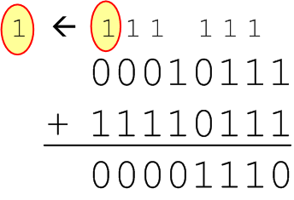
2.4 Signed Integer Representation
Example:
  Using two’s complement binary arithmetic, find the sum of 23 and -9.
  We see that there is carry into the sign bit and carry out. The final result is correct: 23 + (-9) = 14.
Rule for detecting signed two’s complement overflow: When the “carry in” and the “carry out” of the sign bit differ, overflow has occurred. If the carry into the sign bit equals the carry out of the sign bit, no overflow has occurred.

